Slide 1
Credit Card Approval – Logistic Regression
Learning Portfolio 1
by David Cloos

Slide 2
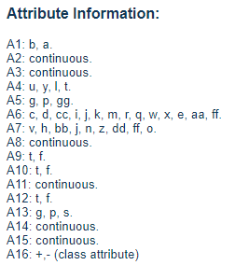

Data Source – UCI Machine Learning Repository
Contains a good mix of attributes:
continuous, nominal with small numbers of values, and nominal with larger numbers of values
Ratio approved / denied
https://archive.ics.uci.edu/ml/datasets/Credit+Approval

Slide 3
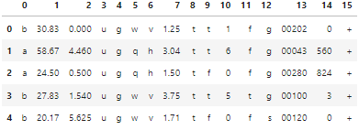
Data.head()
Column 15 = Label
+ = approved
-= denied

Slide 4
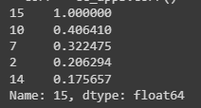
Correlations

Slide 5
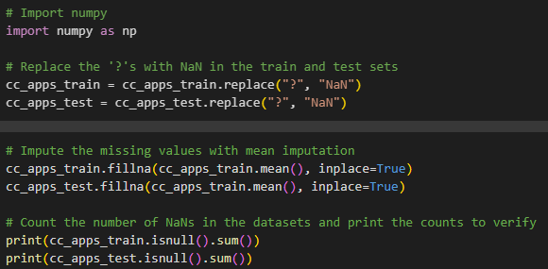
Deal with missing values

Slide 6
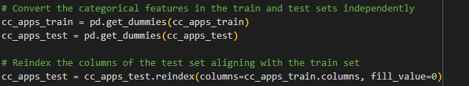
Convert categorical attributes to numerical

Slide 7
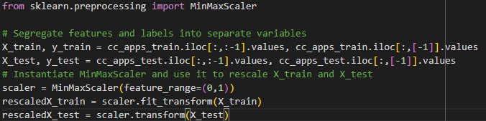
Rescale - Min Max Scaler

Slide 8
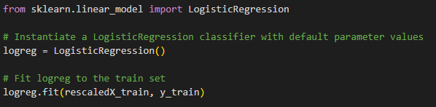
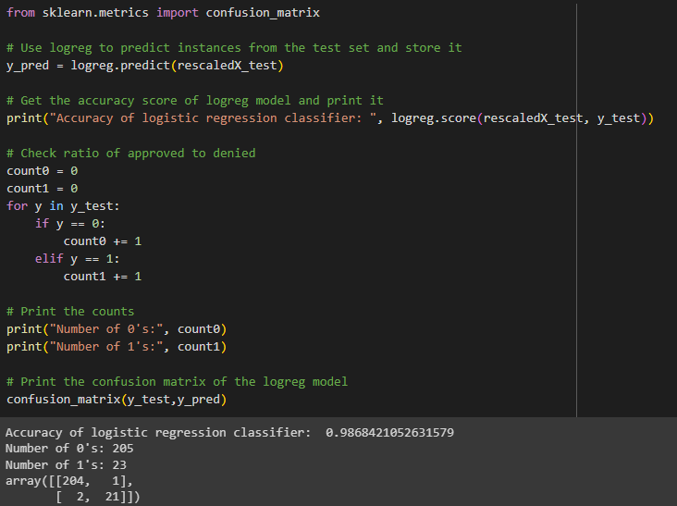
Logistic Regression
array[0][0] => 204 times denied and also our model predicted denied
array[0][1] => 1 time denied where our model predicted approved
array[1][0] => 2 times approved where our model denied
array[1][1] => 21 times approved where our model also approved
accuracy at 98%

Slide 9
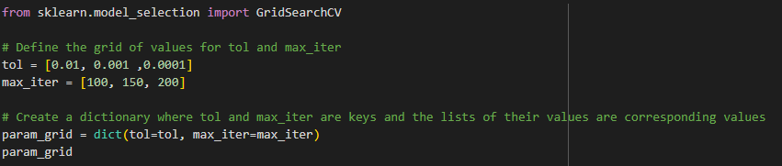
Hyperparameter Tuning

